Slide 1

Website design
In honour of Chris Rock

Slide 2
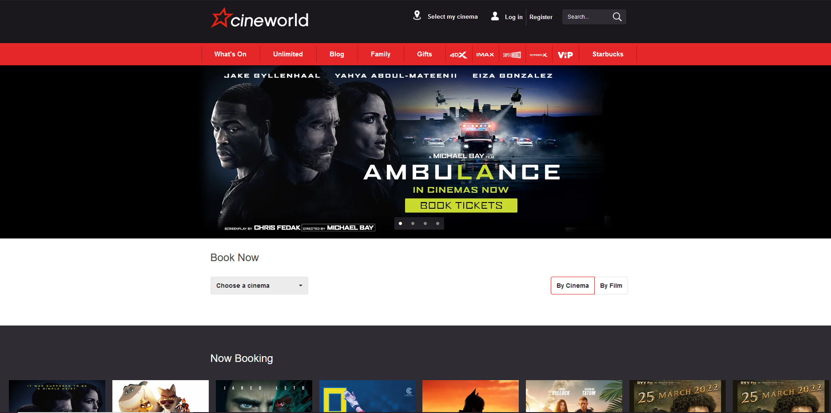
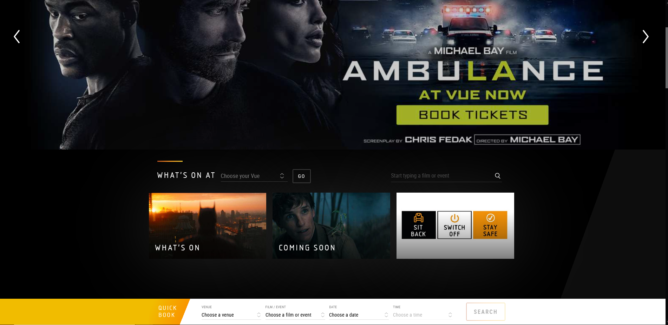
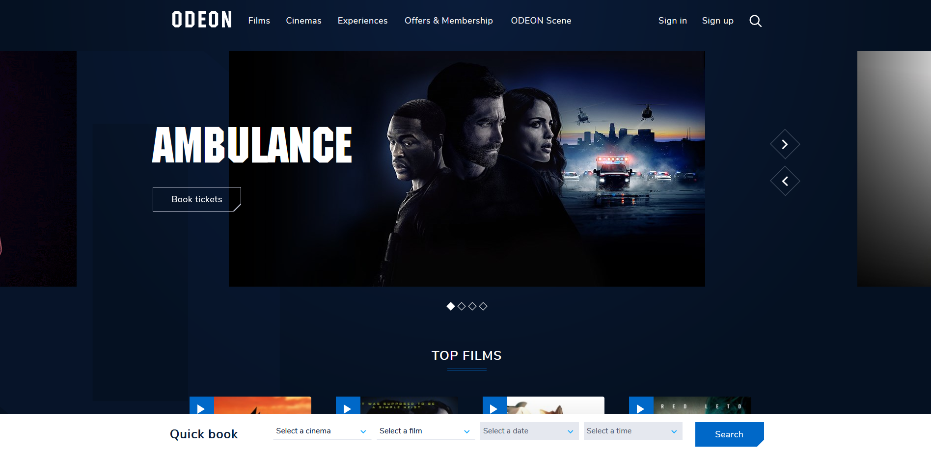
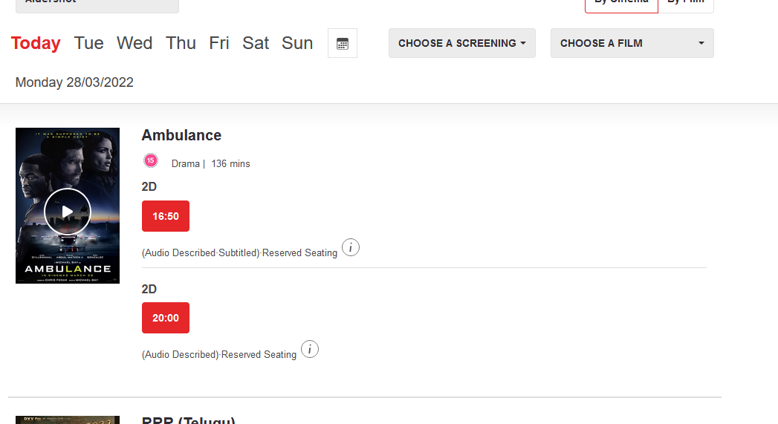
Inspiration

Slide 3
The pages we will need
Home Page
Listings Gallery
Opening Times (movie timings essentially)
New Releases
Classification
Screens (including seating plan)
Ticket bookings page
Payment screen
Getting there Page
Discussion board
Can be merged with listings gallery
Search function
Email form
About page
Contact page

Slide 4
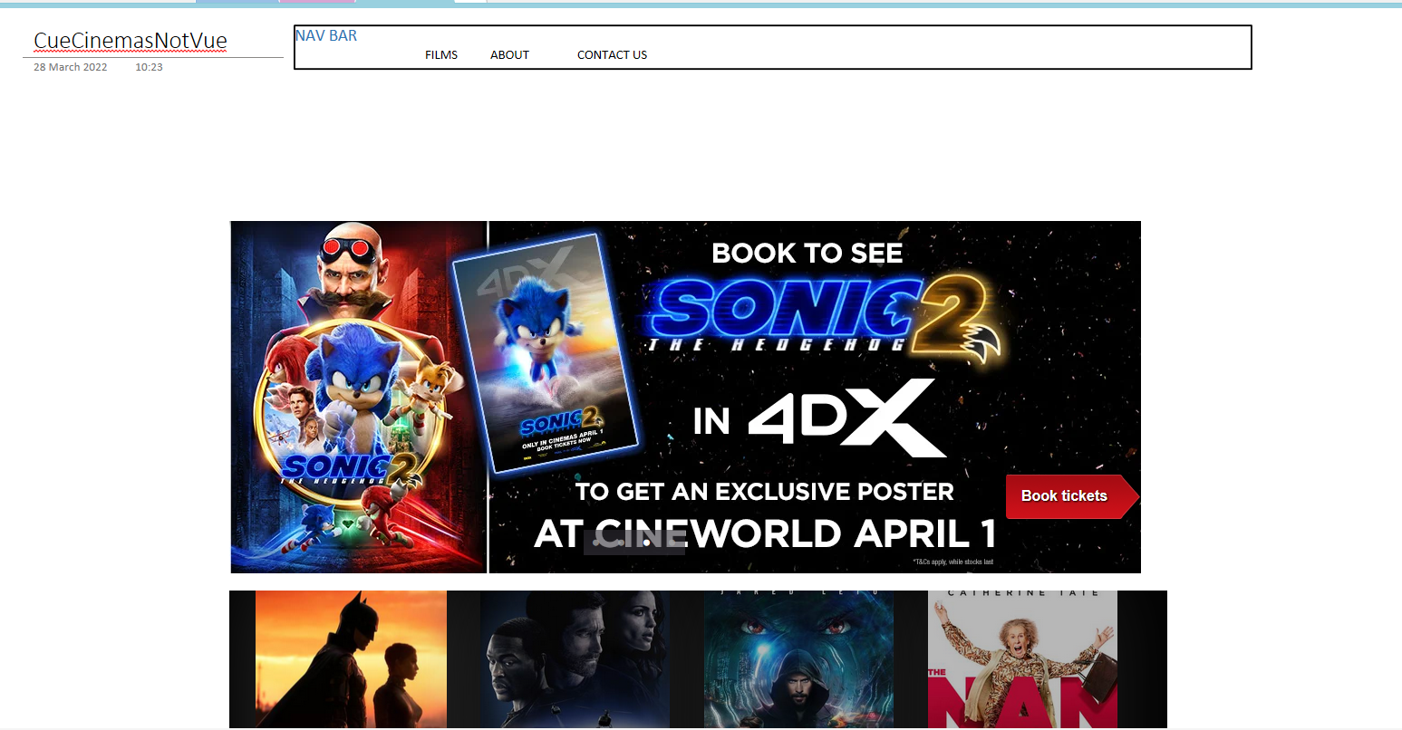
Home Page

Slide 5
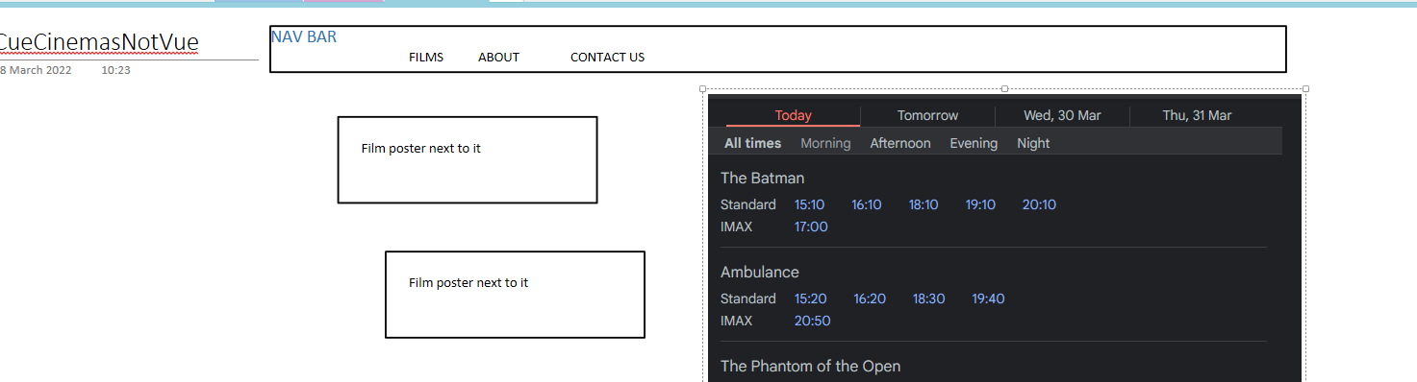
Films page

Slide 6
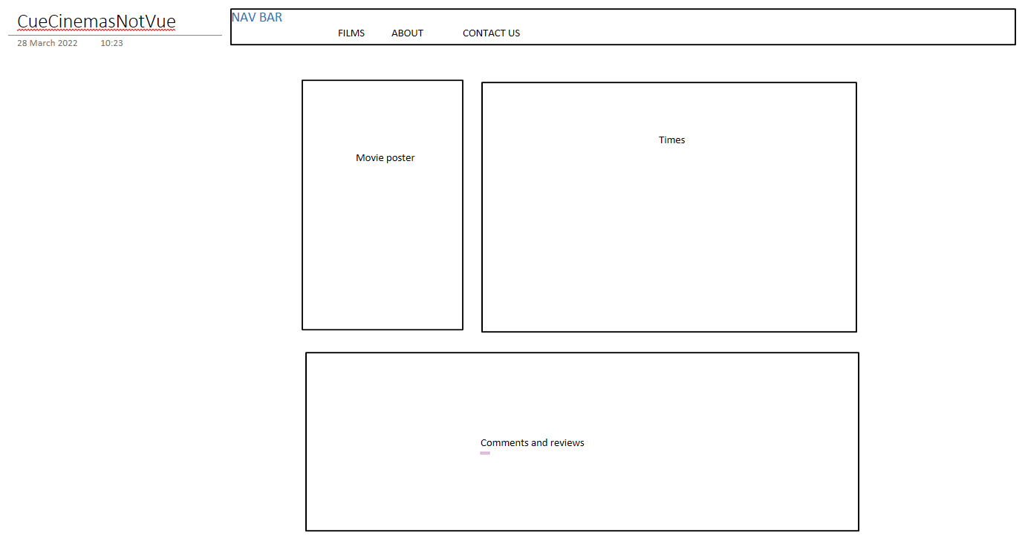
Individual Film page

Slide 7
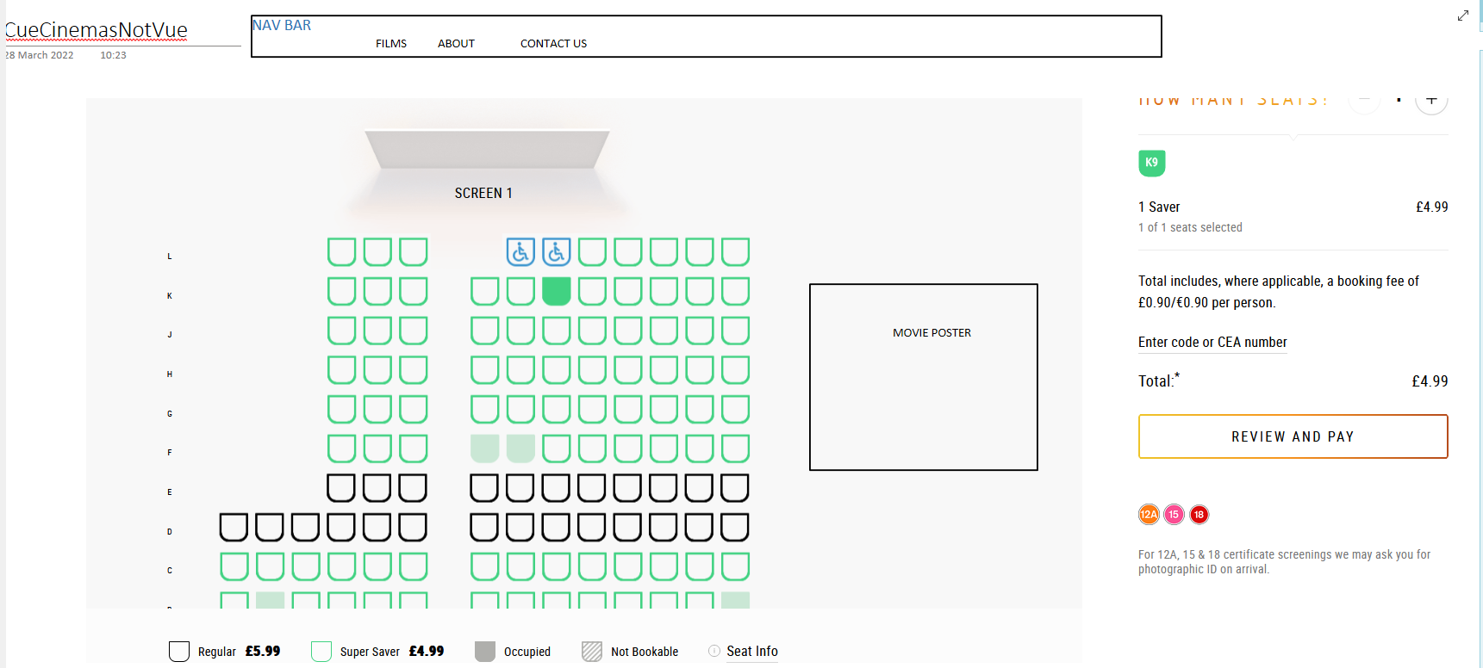
Seat Layout

Slide 8
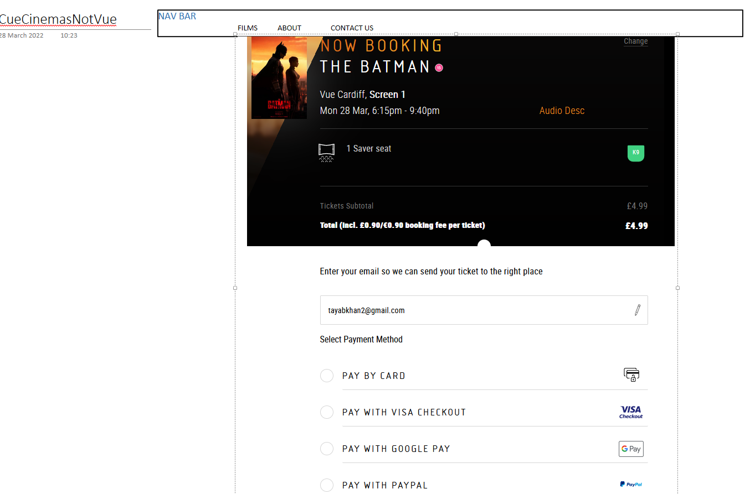
Payment Screen

Slide 9
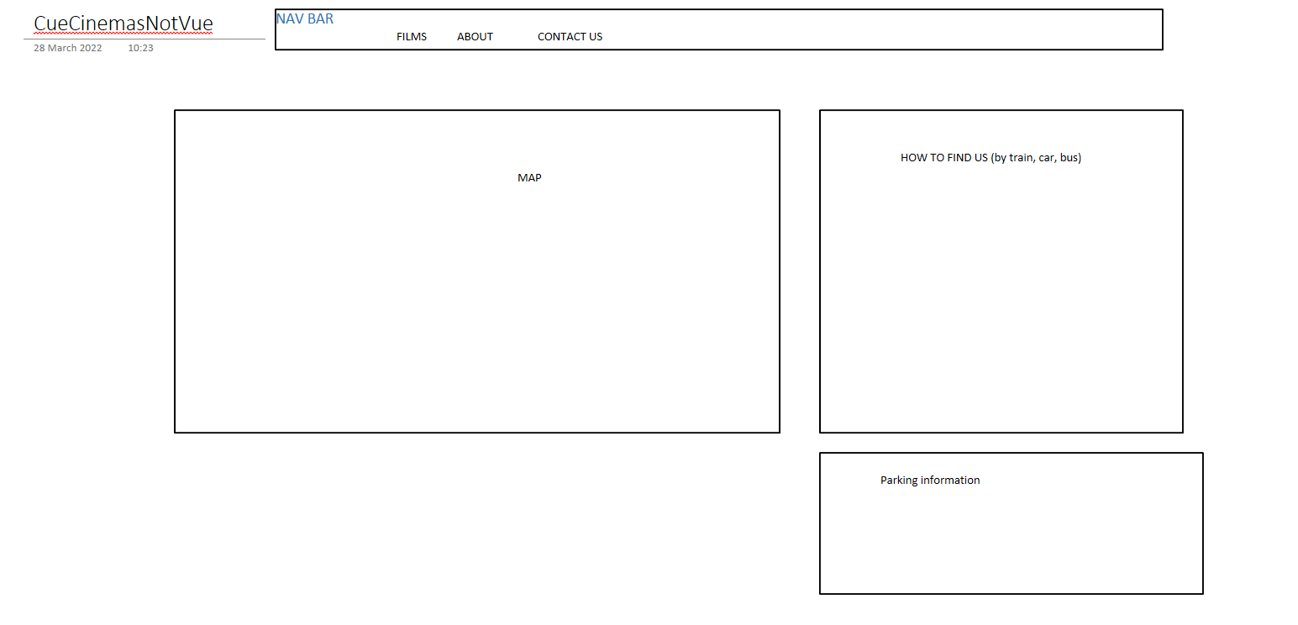
“Getting there” page

Slide 10
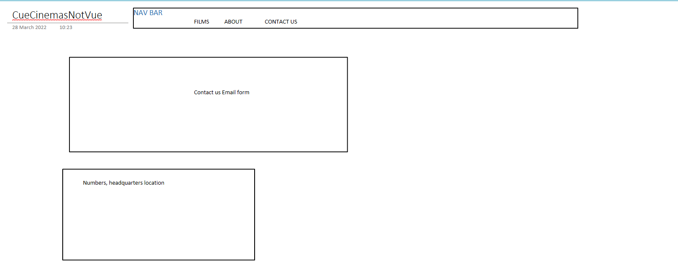
Contact Us Form

Slide 11
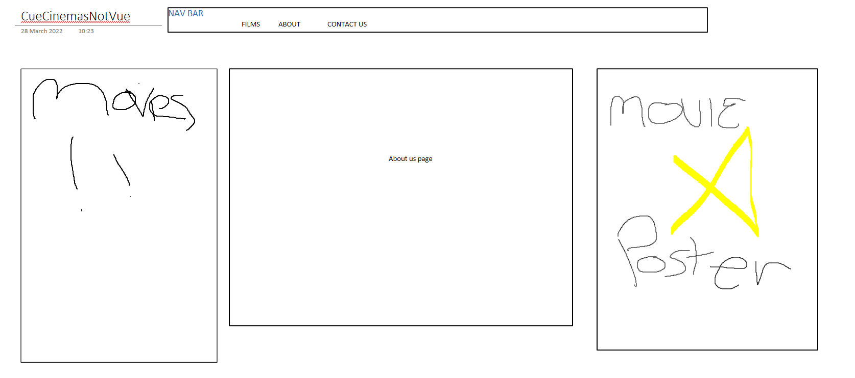
About us

